Slide 2
… Incoming transmission …

Slide 3
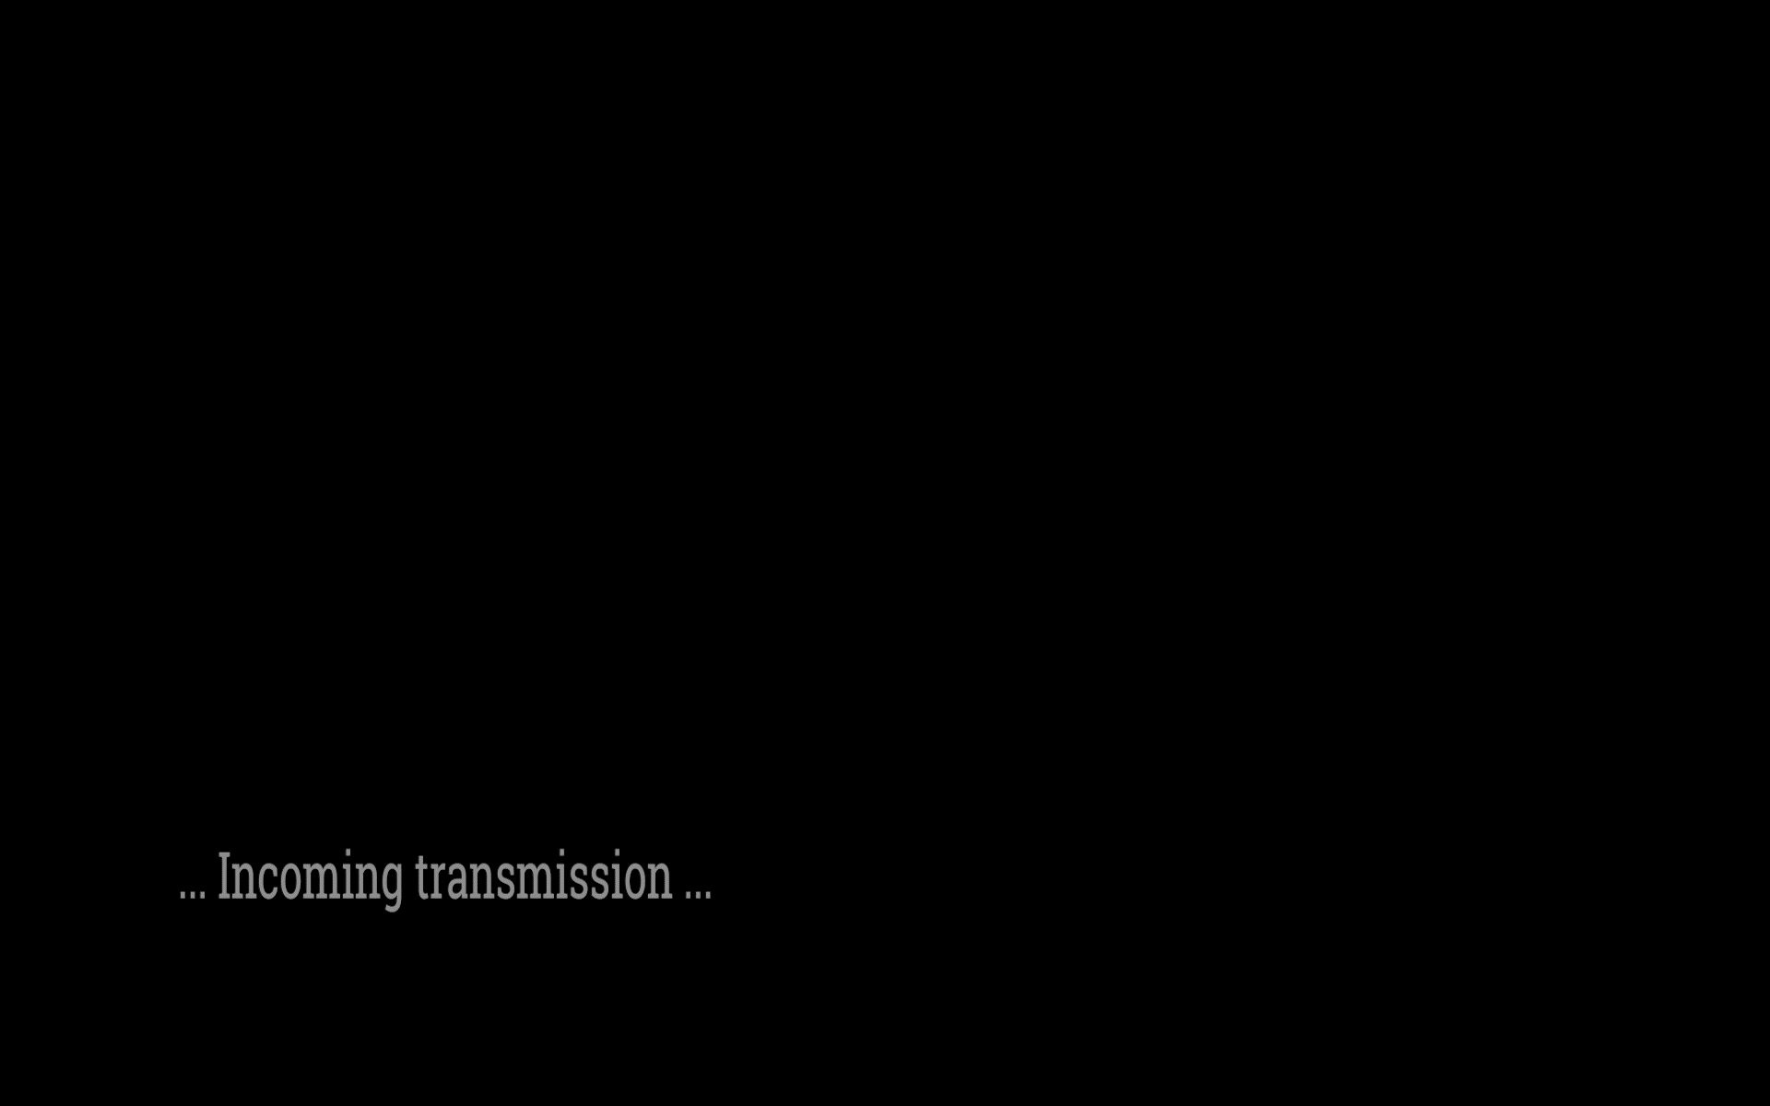

Slide 4
Link to video

Slide 5
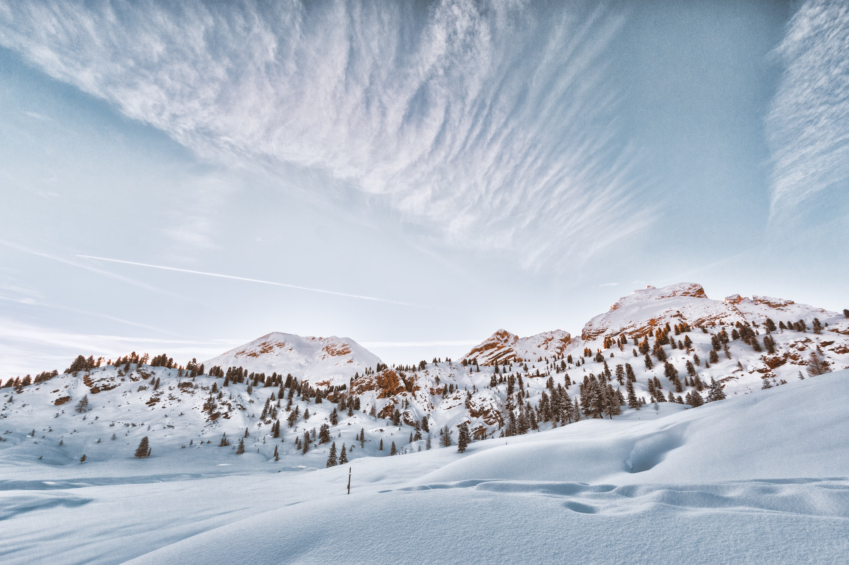
expedition_one

Slide 6
//mission overview
use dope tech
provisioning
Leveraging Terraform and/or Ansible tooling;
Automate the deployment of a compute environment
deployment
Automate the deployment of a containerized app
Demo
Make it repeatable
Present your tech

Slide 7
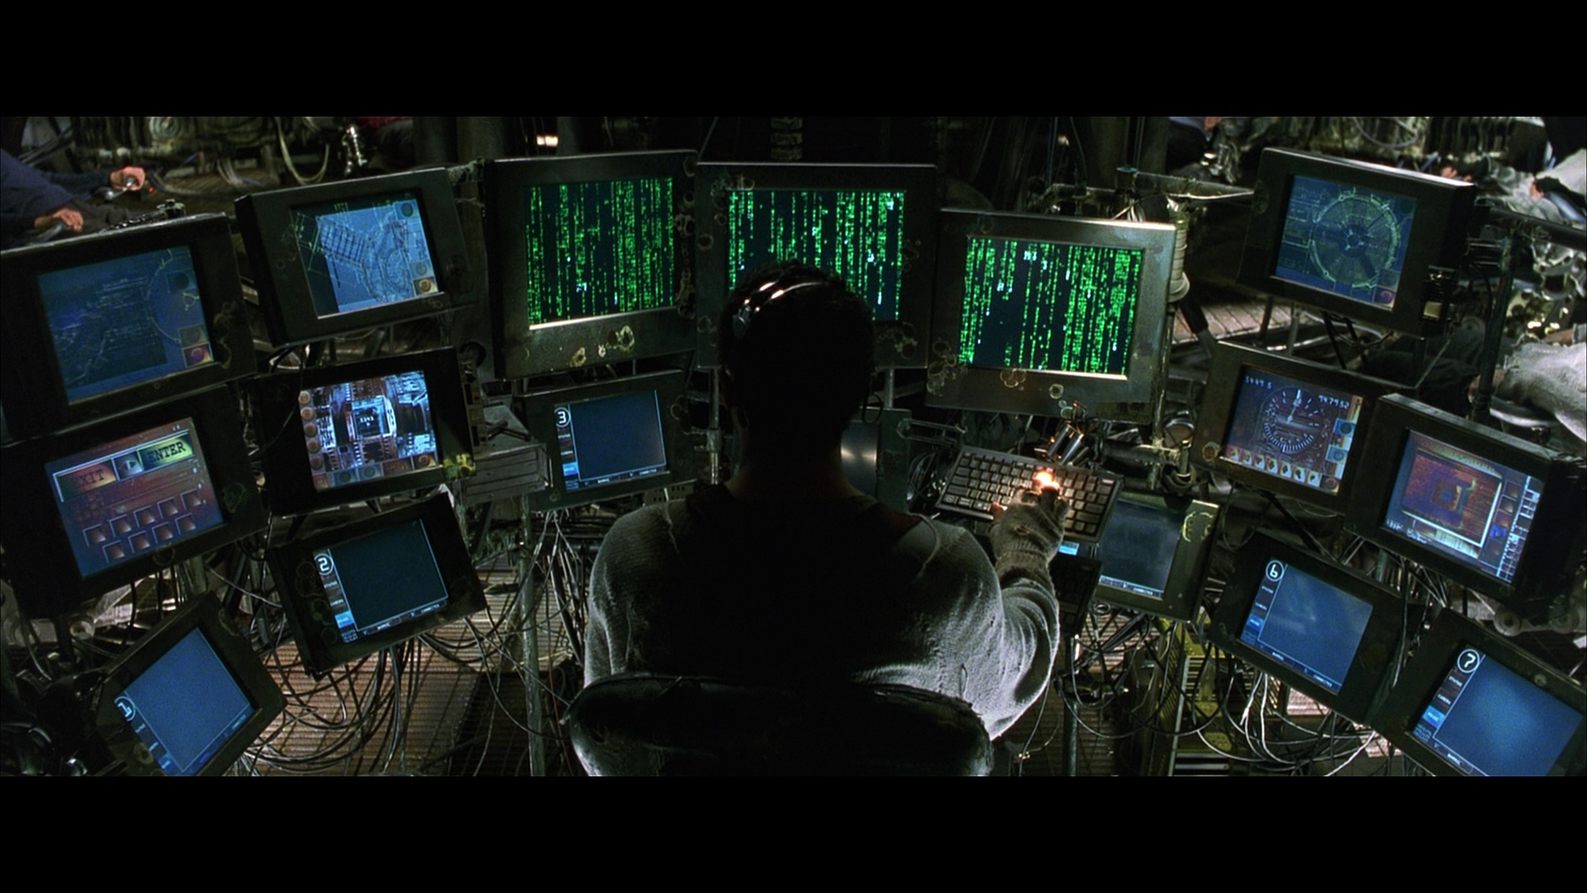

Slide 8
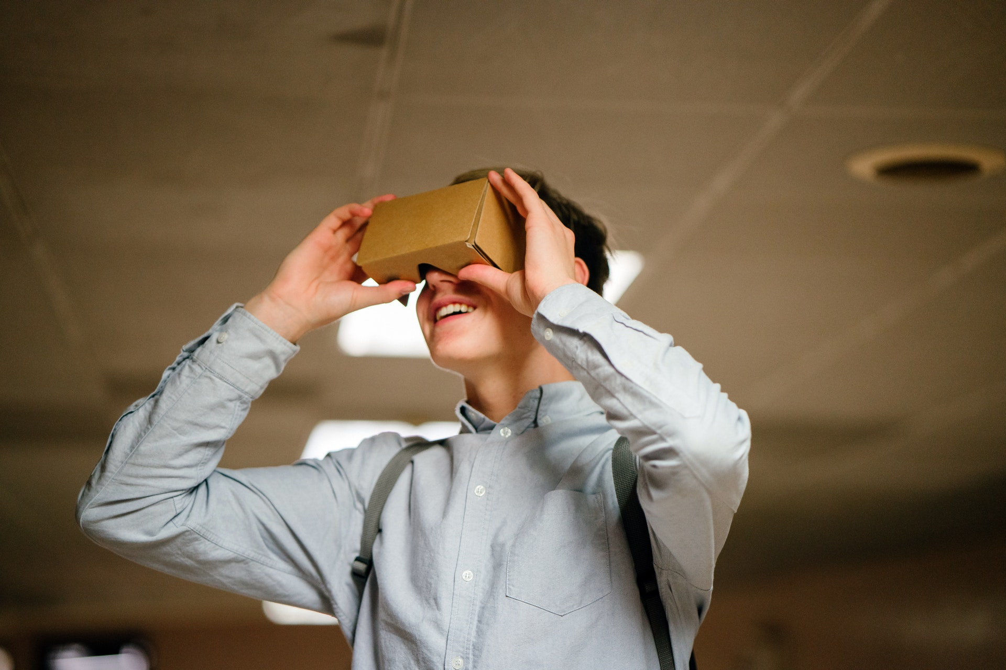

//demo & stumbling blocks

Slide 9
//debriefing
Thank you for your time!

Slide 10
expedition_one over and out

Slide 11
… End of transmission …

